Slide 1
Final stage gate
By: Bella Beattie, Emma Sunderland, Henna Fraiman

Slide 2
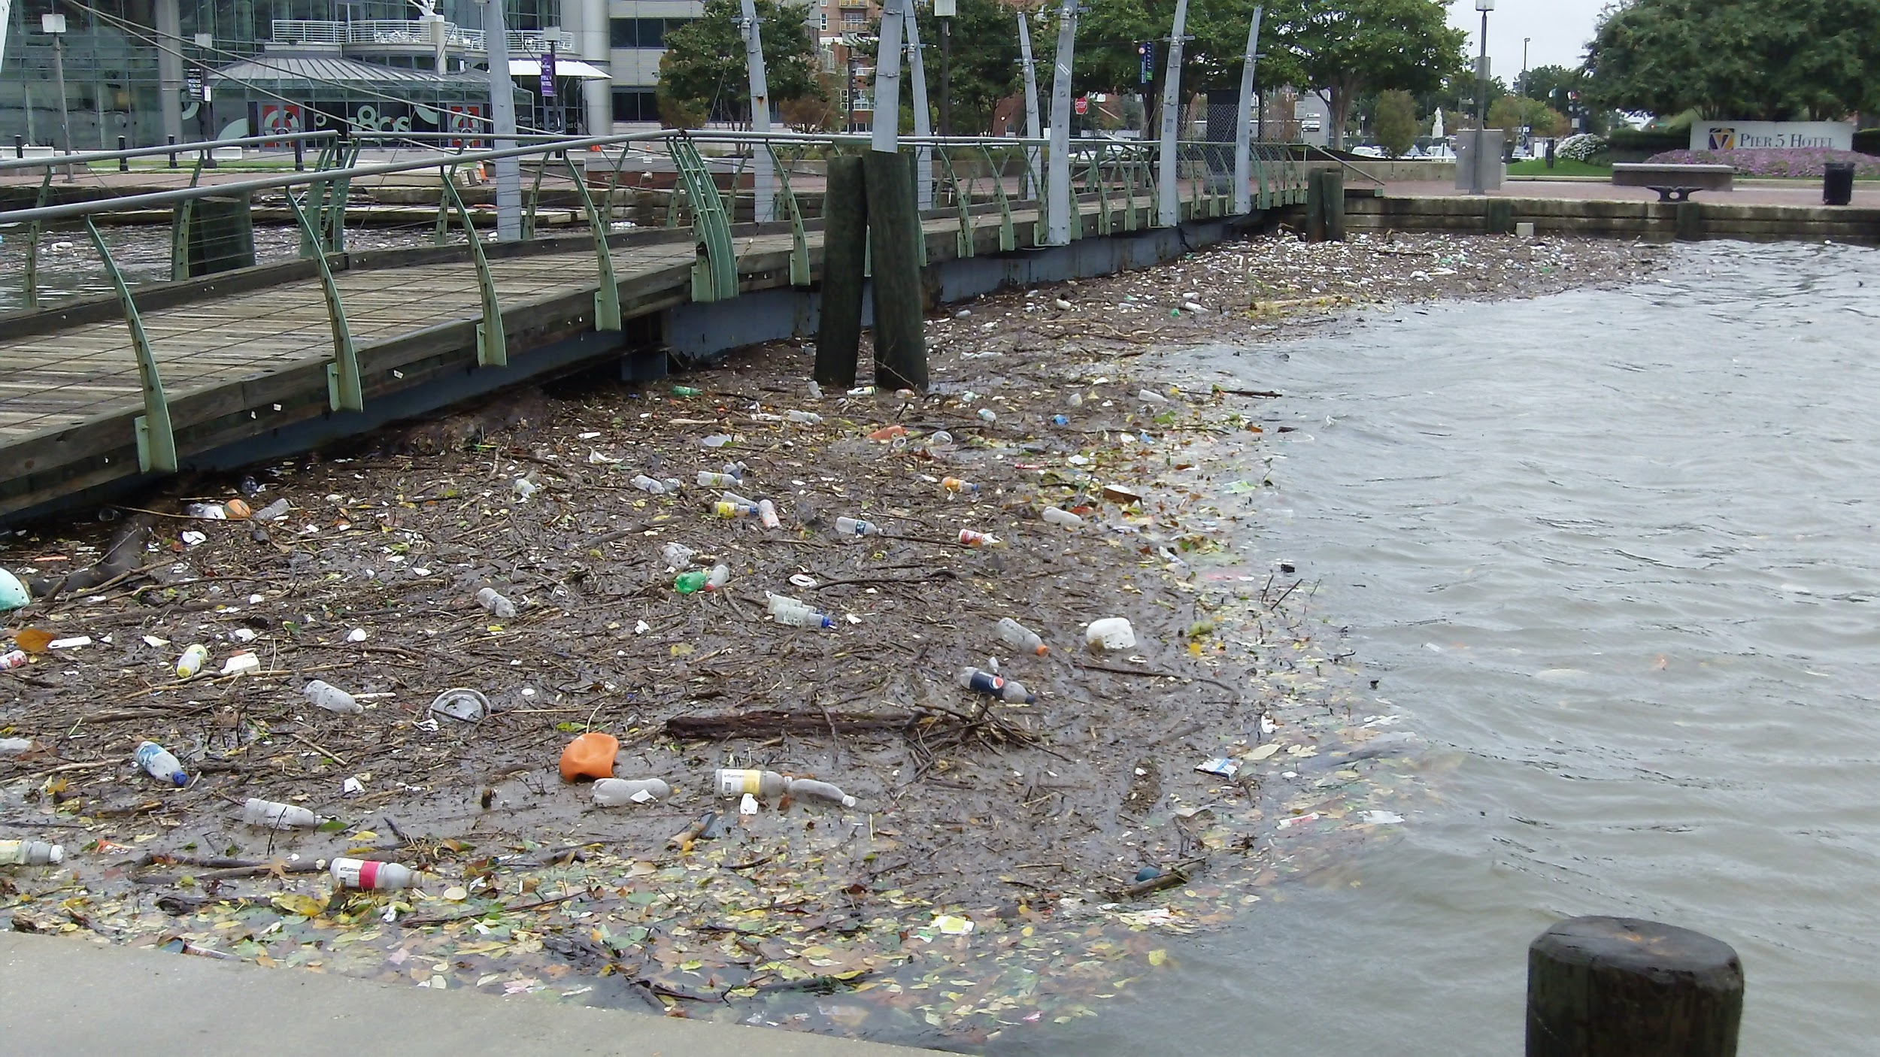
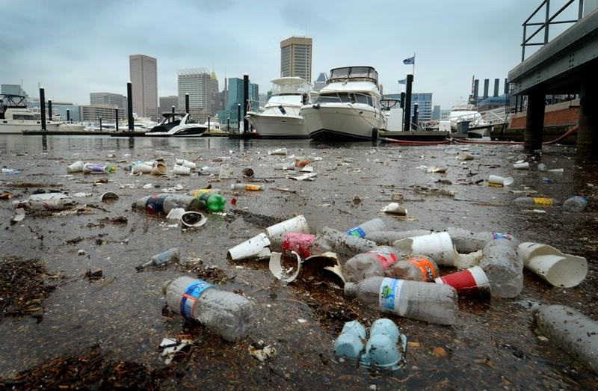
Harbor Pollution in Baltimore
Our group was concerned about the large amount of trash that fills Baltimore Harbor
This trash releases dangerous chemicals
There are hundreds of tons of trash in the harbor

Slide 3
Our Idea
To create a programmed robot that is able to detect trash, collect the trash, and empty the trash to a landfill outside of the harbor

Slide 4
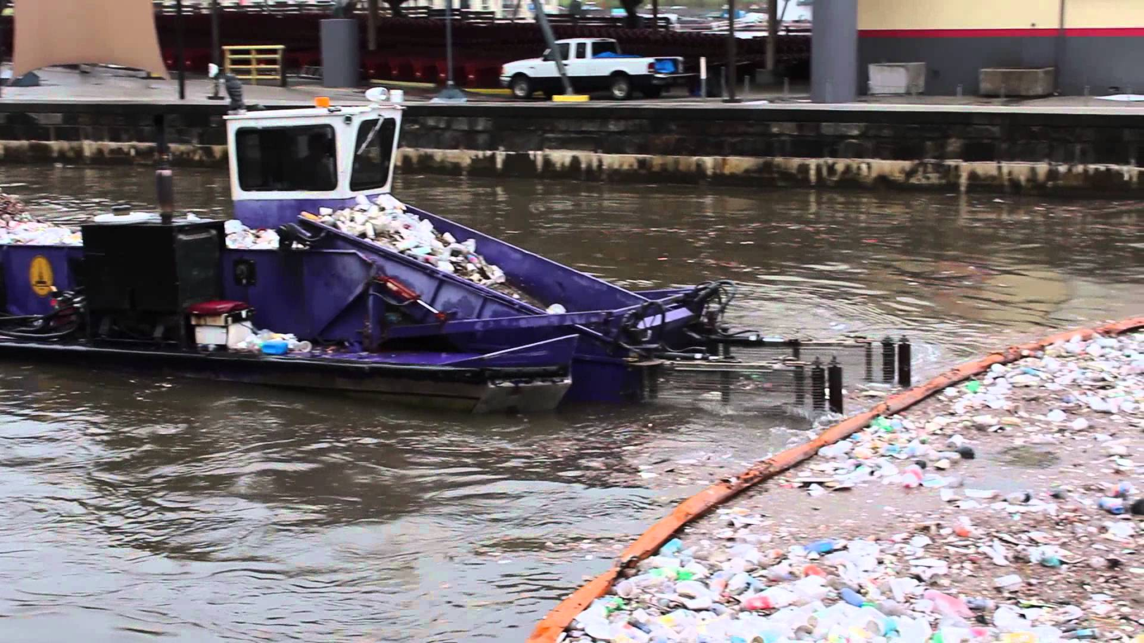
What already Exists
Notes:
This boat picks up the trash with its arms, and puts in into the boat. The boat is manually driven.
Our project will differ from this because we are creating a robot that potentially we not need to be controlled by a human.
Trash goes to a landfill

Slide 5
Summary and Explanation of cost analysis
Item | Quantity | Price/ Link
Sphero 2.0 | 1 | $130 http://www.amazon.com/Sphero-SPRK-Edition-App-Enabled-Ball/dp/B01287R956
Pool noodle | 1 | $2.44 http://www.amazon.com/Soak-SOAAN0101-Water-Noodle-Toy/dp/B00X2WCGF0/ref=sr_1_17?ie=UTF8&qid=1462386650&sr=8-17&keywords=pool+noodle
Duct Tape | 1 roll | $6.04 http://www.amazon.com/Scotch-1110-C-Multi-Duct-10-Yards/dp/B0014LOZVO/ref=sr_1_5?ie=UTF8&qid=1462386748&sr=8-5&keywords=duct+tape
Dissecting metal probes | 6 | $11.82 ($1.97 for 1 unit) http://www.mansionschools.com/probe-and-seeker-mall-6-inches-b240-1-biology-dissecting-instruments.html?channelid=GoogleAdwords&gclid=CjwKEAjwpfC5BRCT1sKW2qzwqE0SJABkKFKR-2pyS8L0eSFIvMslj5N3eOKaPg22vKxyd5ZA0VwIvBoCMOvw_wcB
Total cost: $150.30

Slide 6
Project constraints
Minimum cost
Minimum amount of pool noodle to have a smaller environmental impact
No more than 1 robot
Size of raft based on 1 robot
Length of operation time
Battery life
Collect a maximum amount of trash
Notes:
Don’t have the contraption yet
Dont want it to be too big or too small

Slide 7
Testing process
Test the robot in the pool
See if the robot moves the raft without flipping over
Notes:
Move all 4 directions

Slide 8
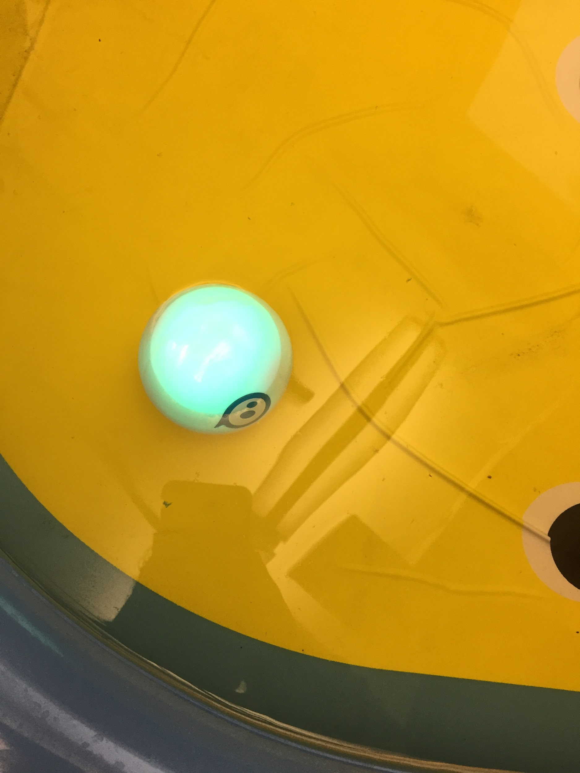
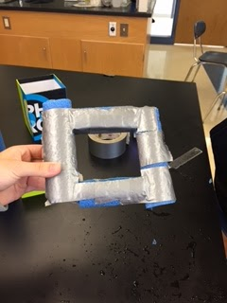
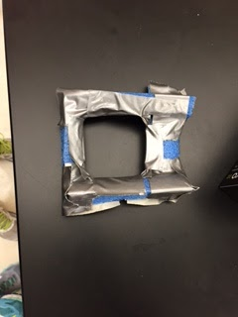
Our Design
Just sphero First Design Second Design
Notes:
Currently, we are building a raft to help the sphero move along the water better.
The

Slide 9
Second design
This raft worked but
It only allowed the robot
To move in one direction

Slide 10
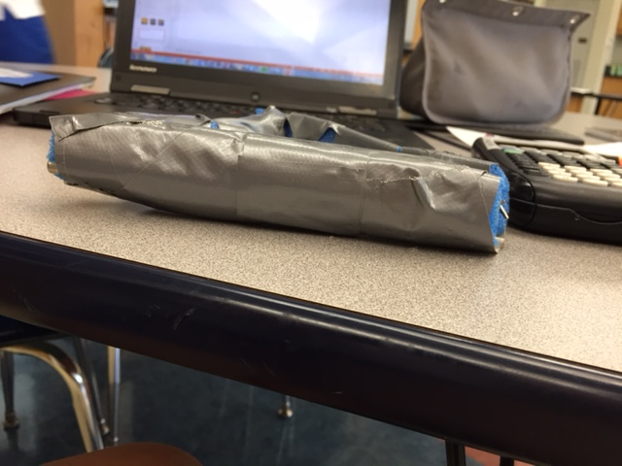
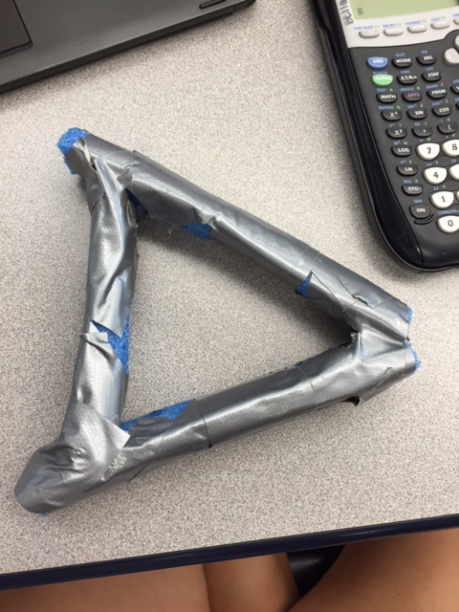
Third design
Notes:
Unstable and we added weights to submerge the boat. Submerging the raft in the water allowed it to spin more

Slide 11
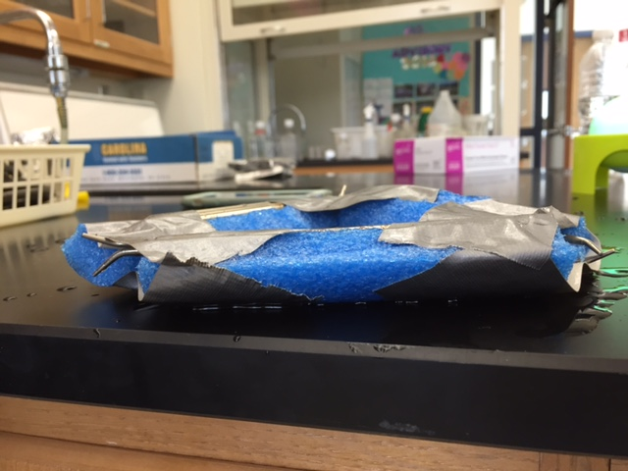
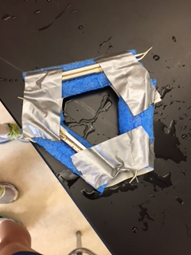
Our design (continued)
Fourth design
Notes:
Wide pool noodle for stability

Slide 12
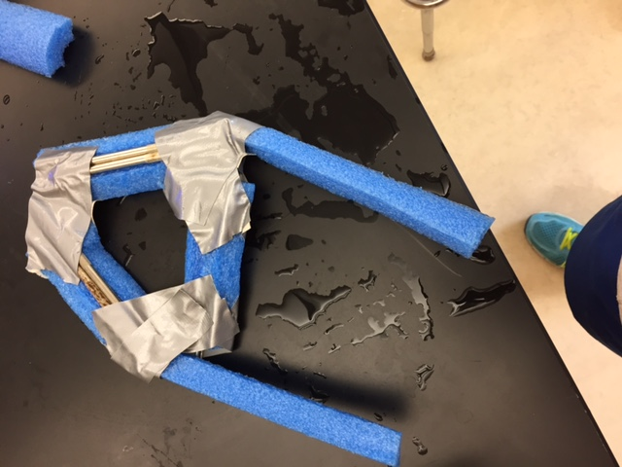
Final Design
Notes:
Added weights to submerge the robot so that it could roll better

Slide 13
Conclusion
We accomplished the goal of creating a raft that allowed the robot to move in all 4 directions. However if we had more time we could have added a net to hold the trash or improved the quality of the arms by adding more stability.

Slide 14
Sources
https://www.youtube.com/watch?v=3FSkzL5kfsI
http://www.aqua.org/blog/2010/october/a-picture-perfect-reason-not-to-litter?mobile=0
http://thedailyrecord.com/2012/07/20/maryland-moment-harboring-trash/

